Slide 1
Distribution in Statistics
An overview of types, meaning, and importance

Slide 2
What is Distribution?
• Distribution shows how values are spread or arranged.
• It can be in terms of frequency or probability.
• Helps us understand the behavior of data.

Slide 3
Key Concepts
• Data Distribution: Spread of actual data points.
• Probability Distribution: Likelihood of outcomes.
• Frequency Distribution: How often each value appears.

Slide 4
Probability Distribution
Understanding the concept and its types

Slide 5
What is Probability Distribution?
• A probability distribution describes how the values of a random variable are distributed.
• It shows the probability of each possible outcome.
• It can be either discrete or continuous.

Slide 6
Types of Probability Distributions
• Discrete Probability Distribution
- Values are countable (e.g., number of heads in coin tosses).
• Continuous Probability Distribution
- Values are uncountable and lie on a continuum (e.g., height, weight).

Slide 7
1. Discrete Probability Distributions
These distributions are used when the outcomes are countable (finite or infinite, but countable).
Type | Description | Example
Binomial Distribution | Models number of successes in n independent trials (success/failure) | Tossing a coin 10 times: What is the probability of getting 6 heads?
Poisson Distribution | Models number of times an event happens in a fixed interval | Number of emails received per hour
Geometric Distribution | Probability of first success on the k-th trial | How many coin flips until the first head

Slide 8
2. Continuous Probability Distributions
Type | Description | Example
Normal Distribution | Bell-shaped, symmetric around the mean | Heights of people in a population
Exponential Distribution | Time between independent events in a Poisson process | Time until next earthquake in a region
Uniform Distribution | All outcomes equally likely over a range | Random number generator between 1 and 100

Slide 9
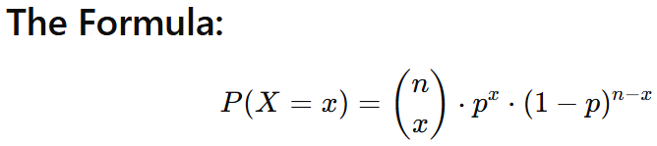
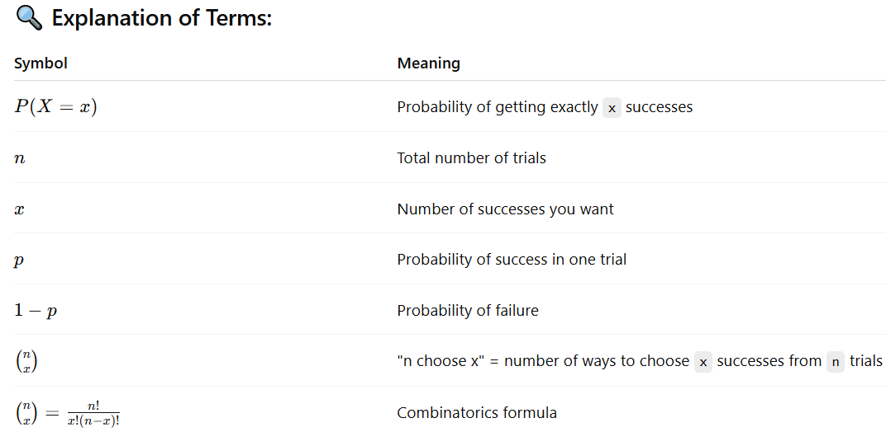
What is the Binomial Distribution Formula?
The binomial distribution is used to model the number of successes in a fixed number of independent trials, where each trial has only two outcomes: success or failure (like tossing a coin).

Slide 10
You toss a fair coin 4 times. What is the probability of getting exactly 2 heads.

Slide 11
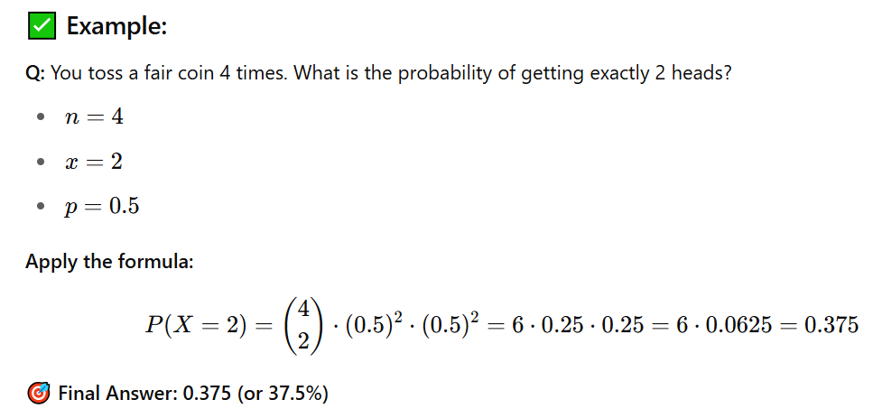

Slide 12
Poisson Distribution
What is Poisson Distribution?
Poisson distribution is used to model the number of events occurring in a fixed interval of time or space, when:
Events occur independently.
The average rate (λ = lambda) is known.
Two events cannot occur at the exact same instant.

Slide 13
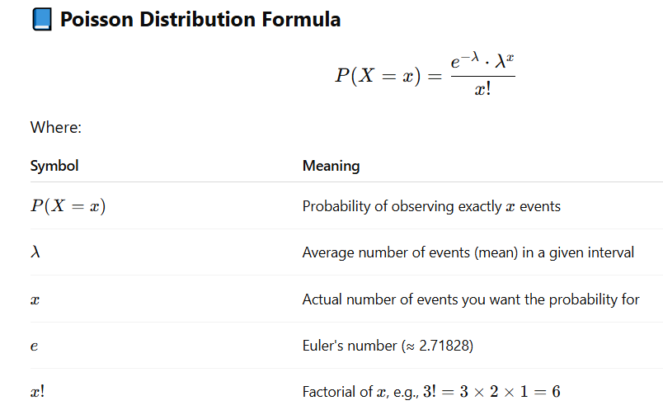

Slide 14
Suppose a call center receives on average 4 calls per minute.
What is the probability that in a given minute, they receive exactly 2 calls?

Slide 15
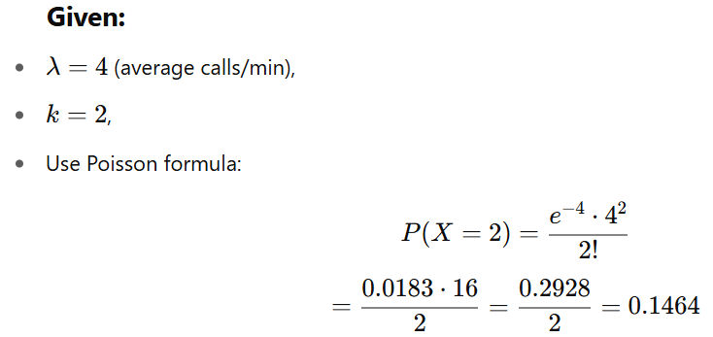

Slide 16
What is Geometric Distribution?
Geometric distribution models the number of trials needed to get the first success in repeated independent Bernoulli trials (success/failure), where the probability of success remains constant.

Slide 17
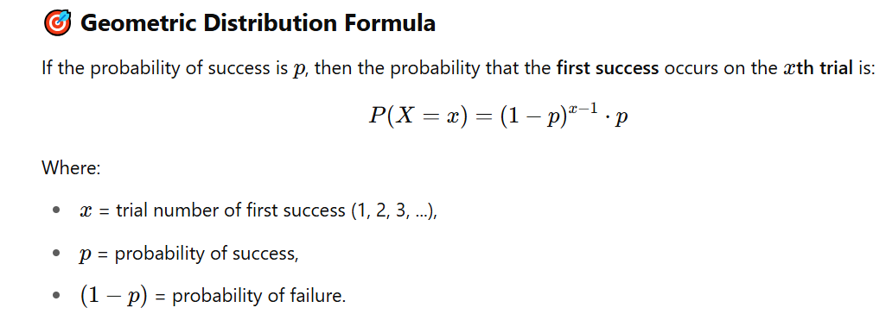
Geometric Distribution
If the probability of success is p, then the probability that the first success occurs on the xth trial is:

Slide 18
Real-Life Example
You’re making phone calls, and the chance someone picks up is 0.2.
The geometric distribution models how many calls you need to make until someone
You are tossing a biased coin
Probability of getting Heads (success) is p=0.3

Slide 19
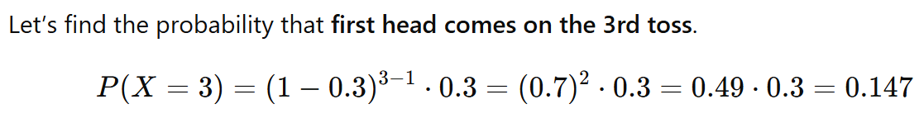

Slide 20
What is Normal Distribution?
The Normal Distribution is a continuous, bell-shaped distribution that models many real-world phenomena like:
Heights of people
Exam scores
Measurement errors
It is symmetric around the mean (average), and is defined by:
μ (mu) = mean
σ (sigma) = standard deviation

Slide 21
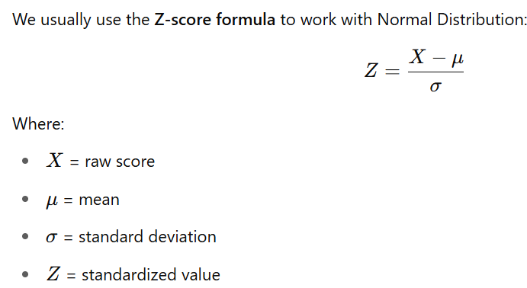
We usually use the Z-score formula to work with Normal Distribution:
Numerical Example:
Let’s say:
The average score (μ) on a math test is 70
The standard deviation (σ) is 10
You want to find the probability that a student scores less than 85

Slide 22
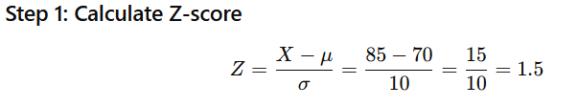
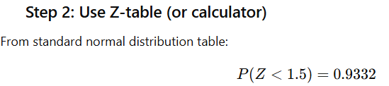


Slide 23
Applications of Normal Distribution
1. Natural and Biological Sciences
Human characteristics like height, weight, blood pressure, and IQ scores follow a normal distribution.
Measurement errors in physical experiments tend to be normally distributed due to random fluctuations.
2. Business and Finance
Stock market returns: Daily changes in stock prices often approximate a normal distribution over short periods.
Risk management: Value-at-Risk (VaR) models assume normal distribution to estimate potential losses.
Quality control: Normal distribution is used in Six Sigma and control charts to monitor manufacturing defects and variation.

Slide 24
Applications of Normal Distribution
3. Social Sciences and Psychology
Standardized testing: SAT, GRE, and IQ scores are normalized so they have a mean of 100 and a standard deviation of 15 (or another value).
Behavioral traits and surveys often assume normal distribution for inferential analysis.
4. Engineering
Signal processing and noise modeling often use the normal distribution to model thermal noise in electrical circuits.
Reliability analysis: Lifetimes of components under specific conditions can sometimes follow a normal distribution.

Slide 25
Applications of Normal Distribution
5. Machine Learning and Data Science
Feature scaling and normalization: Some algorithms assume data is normally distributed (e.g., Linear Discriminant Analysis, Gaussian Naive Bayes).
Assumptions in regression: Linear regression assumes normally distributed residuals (errors).
Bayesian methods: Gaussian priors are often used in probabilistic modeling.
6. Education and Grading
Grading on a curve (bell curve) assumes students’ performance follows a normal distribution, helping assign grades like A, B, C based on percentile ranks.

Slide 26
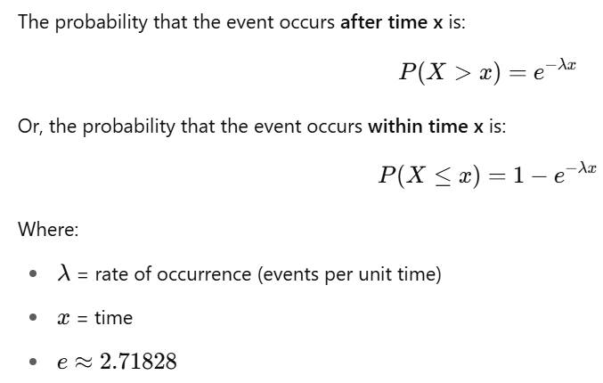
Exponential Distribution
The Exponential Distribution models the time between events in a Poisson process — when events happen continuously and independently at a constant average rate.
It is used to model waiting times between:
Customer arrivals at a counter
Calls in a call center
Failures of machines

Slide 27
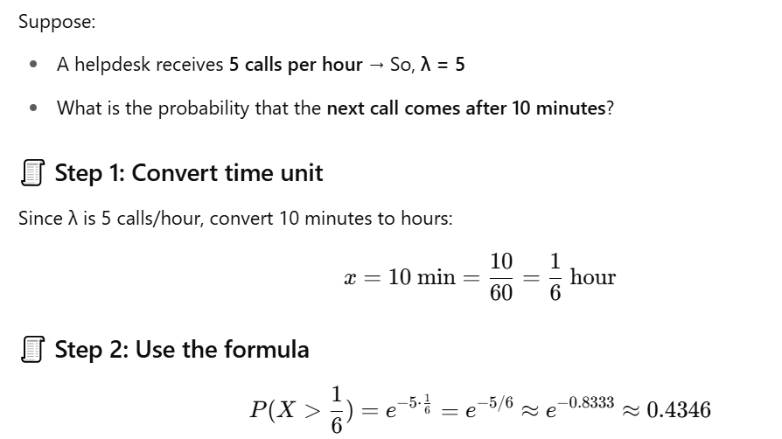

Slide 28
Importance of Probability Distribution
• Forms the foundation of statistical inference.
• Helps model uncertainty and randomness.
• Guides decision making in business, finance, science, etc.

